Slide 1


Team 1
Food Brand Understand Customer Trends

Slide 2

OUR TEAM
01. Ganji Sindhu Priya
02. Parul Gautam
03. Varanasi VinayKumar
04. Rohan Raj
Under the Guidance of
PAVITRA KANNAN

Slide 3

OVERVIEW
Introduction
Project Overview
* Key Features
* Tech Stack
* Milestones
Conclusion

Slide 4

INTRODUCTION
Project Overview:
This project applies sentiment analysis to customer feedback to track Positive, Negative, and Neutral responses. It helps identify key patterns across time, region, channel, product, and customer segments.
Core Functionalities:
Interactive dashboards show sentiment distribution with KPI cards, trend lines, and comparison charts. They highlight top negative products, sentiment by region/channel, and segment-level insights.
Outcomes:
Sentiment distribution: 40.9% Positive, 39.3% Negative, 19.8% Neutral. In-store orders showed higher negatives. Loyal customers gave the most positives, while Panipuri, Crispy Paneer Roll, and Cold Coffee drew maximum complaints.

Slide 5

PROJECT OVERVIEW
Key Features:
This project classifies customer feedback into Positive, Negative, and Neutral sentiments.
DAX-based measures are created to calculate the percentage of Positive, Negative, and Neutral feedback.
Visualizations are built to track sentiment by Time, Region, Channel, Segment, and Product.
The focus is on identifying top complaints and positive drivers to guide business improvements.

Slide 6

TECH STACK
Power BI: Primary tool for developing interactive dashboards to visualize sentiment trends and insights across regions, channels, products, and customer segments.
DAX (Data Analysis Expressions): Used to calculate sentiment KPIs (% Positive, % Negative, % Neutral) and derive measures for trend analysis and comparisons.
Microsoft Excel: Utilized for data cleaning, preprocessing, and formatting to ensure seamless integration with Power BI.

Slide 7



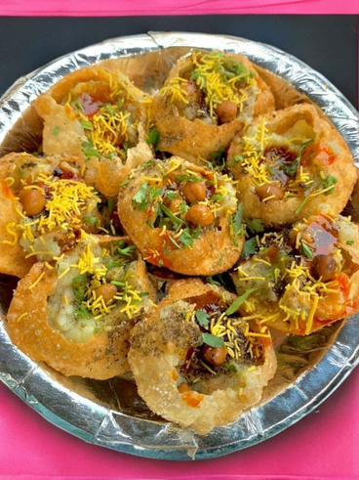

MILESTONES
01
02
03
04
05
Data Collection & Cleaning
Gathered dataset and ensured accuracy through preprocessing.
Feature Engineering
Created measures and customer segments (New, Regular, Loyal).
Sales & Product Dashboard
Built interactive dashboards for sales and product insights.
Customer Insights Dashboard
Analyzed customer demographics, segmentation, and loyalty.
Trends & Recommendations
Identified key trends and suggested strategic improvements.

Slide 8
SENTIMENTAL LOGIC – DAX MEASURES

Slide 9
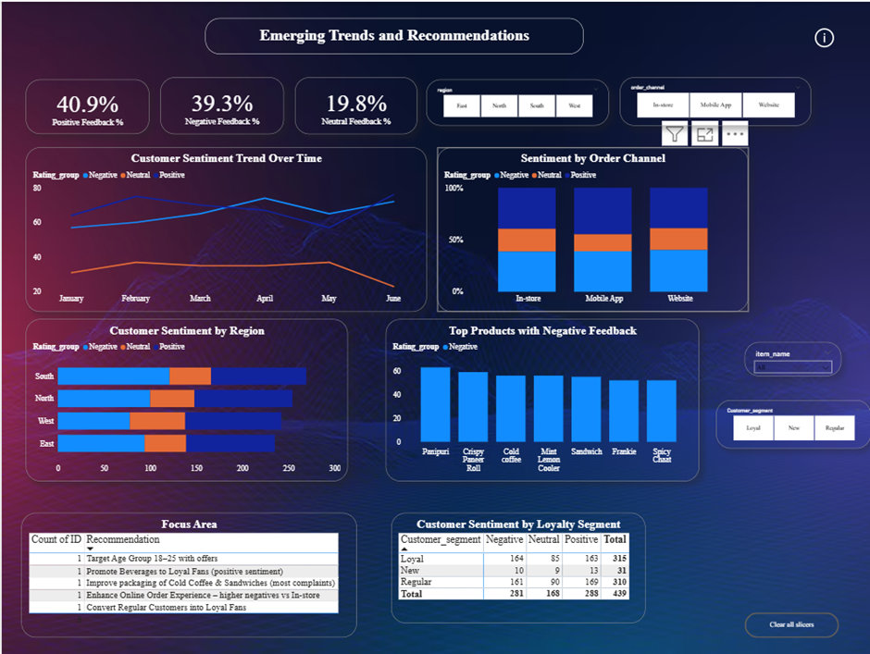
SENTIMENT INSIGHTS DASHBOARD

Slide 10

CONCLUSION
This project delivers a data-driven dashboard to analyze customer feedback and sentiment.
Key features include sentiment classification, trend analysis, and segment-wise insights to support informed decision-making.
Interactive visualizations enable easy comparison of sentiment across products, regions, channels, and customer segments.
Future enhancements could include keyword-based sentiment themes, NLP-driven real-time feedback analysis, and linking sentiment with sales performance for deeper insights.

Slide 11
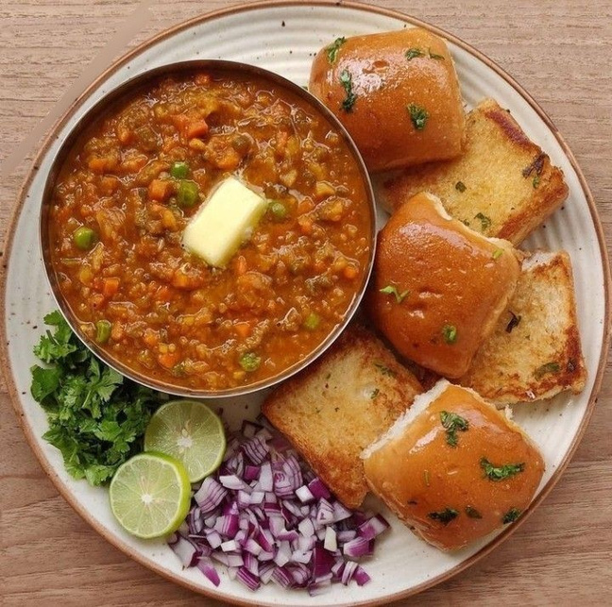
Thank You

